Slide 1
Public Transport tickets in the North East
From April 1st 2025

Slide 2
Under 16
Ticket type | Price | Area of acceptance | Transport mode acceptance | Age
21 & Under single bus ticket Buy on bus or app | £1 | Durham Northumberland Tyne & Wear Cross boundary bus services into Tees Valley |  | Under 22
21 & Under multi-modal day ticket Buy on bus, app, Metro ticket machine | £3 | Durham Northumberland Tyne & Wear |  | Under 22
Under 16 Pop card: Proof of age card which allows you to buy child tickets Buy tickets on bus and Metro ticket machines, with card as proof of age | Proof of age card to access child tickets priced at: Single - 60p All day- £1.10 | Tyne and Wear Northern rail services between Newcastle and Sunderland Northern rail services between Newcastle and Metrocentre/Blaydon |  | Ages 5 - 15
Junior Blue Pop* Pay As You Go smartcard for children aged 5-15 Buy tickets using smartcard | Metro tap on/off: Single Metro - £1.00 All day Metro - £1.90 Bus/ferry tickets paid for using smartcard balance | Durham Northumberland Tyne and Wear Tees Valley Northern rail services between Newcastle and Ashington |  | Ages 5 - 15
M
M
M
M
For further information on each ticket type, including validity and acceptance please click on the name of the ticket type.
* The Junior Blue Pop card automatically works out the cheapest Metro ticket based on the journeys you’ve made. However, it works differently for bus and ferry tickets. If travelling on more than one mode, it is usually cheaper to buy a 21 & Under £3 day ticket.

Slide 3
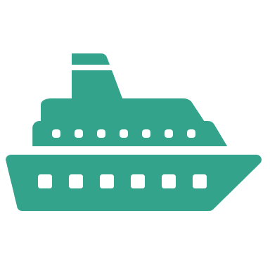
Ages 16 – 18
Ticket type | Price | Area of acceptance | Transport mode acceptance | Age
21 & Under single bus ticket Buy on bus or app | £1 | Durham Northumberland Tyne & Wear Cross boundary bus services into Tees Valley |  | Under 22
21 & Under multi-modal day ticket Buy on bus, app, Metro ticket machine | £3 | Durham Northumberland Tyne & Wear |  | Under 22
Pop Blue* Pay As You Go smartcard for ages 16-21 Buy tickets using smartcard | Metro tap on/off: Single Metro - £1.00 All day Metro - £2.20 Bus/ferry tickets paid for using smartcard balance | Durham Northumberland Tyne and Wear Tees Valley Northern rail services between Newcastle and Ashington |  | Ages 16 -21
18 and Under Metro Season ticket ** Use smartcard | Provides a 60% discount compared to an adult Metro season ticket | Tyne & Wear Northern rail services between Newcastle and Ashington Northern rail services between Newcastle and Sunderland – T&Cs apply | Small number of bus services included (click here) | Ages 16-18
M
M
M
M
For further information on each ticket type, including validity and acceptance please click on the name of the ticket type.
*The Pop Blue card automatically works out the cheapest Metro ticket based on the journeys you’ve made. However, it works differently for bus and ferry tickets. If travelling on more than one mode, it is usually cheaper to buy a 21 & Under £3 day ticket.
**If you’re a regular public transport traveller and think a season ticket may be the best option for you, please check the Nexus, Network One and bus operator specific websites (Go North East, Arriva, Stagecoach) to identify which ticketing product is the most suitable for you.

Slide 4
Ages 19 – 21
Ticket type | Price | Area of acceptance | Transport mode acceptance | Age
21 & Under single bus ticket Buy on bus or on app | £1 | Durham Northumberland Tyne & Wear Cross boundary bus services into Tees Valley |  | Under 22
21 & Under multi-modal day ticket Buy on bus, app, Metro ticket machine | £3 | Durham Northumberland Tyne & Wear |  | Under 22
Pop Blue Pay As You Go smartcard for ages 16-21 Buy tickets using smartcard | Metro tap on/off: Single Metro - £1.00 All day Metro - £2.20 Bus/ferry tickets paid for using smartcard balance | Durham Northumberland Tyne and Wear Tees Valley Northern rail services between Newcastle and Ashington |  | Ages 16 -21
Student Metro season ticket ** Use smartcard | Provides a 30% discount compared to an adult Metro season ticket | Tyne and Wear Metro Northern rail services between Newcastle and Ashington Northern rail services between Newcastle and Sunderland – T&Cs apply | Small number of bus services included (click here) | Student
M
M
M
M
For further information on each ticket type, including validity and acceptance please click on the name of the ticket type.
*The Pop Blue card automatically works out the cheapest Metro ticket based on the journeys you’ve made. However, it works differently for bus and ferry tickets. If travelling on more than one mode, it is usually cheaper to buy a 21 & Under £3 day ticket.
**If you’re a regular public transport traveller and think a season ticket may be the best option for you, please check the Nexus, Network One and bus operator specific websites (Go North East, Arriva, Stagecoach) to identify which ticketing product is the most suitable for you.

Slide 5
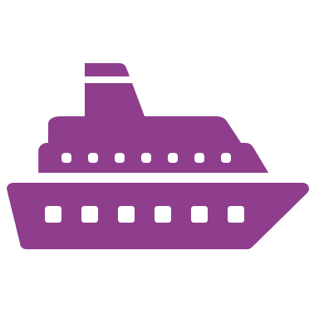
Adult: 22 and over
Ticket type | Price | Area of acceptance | Transport mode acceptance | Age
Adult single bus cap Buy on bus and app | £2.50 | Durham Northumberland Tyne and Wear For cross boundary services into Tees Valley and Cumbria, use the £3 national single cap |  | All
Pop Pay As You Go Smartcard Buy tickets using smartcard | Provides discounted Metro prices compared to paper tickets. Bus/ferry tickets paid for using smartcard balance | Tyne and Wear Durham Northumberland Northern services between Newcastle and Ashington |  | All
Durham Day Rover Buy on bus or app | £5 | Durham |  | All
Northumberland Day Rover Buy on bus or app | £6 | Northumberland |  | All
Tyne and Wear Day Rover Buy on bus, app, Metro ticket machine | £6.80 | Tyne and Wear Northern rail services between Blaydon and Sunderland |  | All
All Day Anywhere Buy on bus, app, Metro ticket machine | £7.50 | Durham Northumberland Tyne and Wear Northern rail services between Blaydon and Sunderland |  | All
Metro Season ticket * Use Smartcard | Provides a discount compared to daily tickets | Tyne and Wear Northern rail services between Newcastle and Sunderland – T&Cs apply | Small number of bus services included (click here) | All
Corporate Metro Season ticket * Use Smartcard | Provides a discount compared to daily tickets which is offered through salary sacrifice for participating employers | Tyne and Wear Northern services between Newcastle and Ashington Northern services between Newcastle and Sunderland – T&Cs apply
M
M
M
M
M
M
M
For further information on each ticket type, including validity and acceptance please click on the name of the ticket type.
*If you’re a regular public transport traveller and think a season ticket may be the best option for you, please check the Nexus, Network One and bus operator specific websites (Go North East, Arriva, Stagecoach) to identify which ticketing product is the most suitable for you.

Slide 6
Concessionary products
Other ticketing options are available to people who are eligible for concessionary travel, this typically includes residents who are older, disabled or people who are companions.
If you think you’re eligible, or are unsure, please check the Government webpage: Managing the English national concessionary travel scheme (ENCTS) - GOV.UK*. If eligible, this may be the best ticketing option for you.
You can apply for a concessionary travel pass via Local Government websites, please see the table below to work out where you should apply and who to contact with queries.
*Eligibility for concessionary travel may vary depending on local authorities, please check the links provided in the table for your area.
Where you live | Website to apply for ENCTS
County Durham | Durham County Council Apply for a bus pass - Durham County Council
Northumberland | Northumberland County Council Concessionary travel pass | Northumberland County Council
Tyne and Wear (including Gateshead, Newcastle, North Tyneside, South Tyneside and Sunderland) | Nexus for Tyne and Wear https://www.nexus.org.uk/ticket-information/concessions For Metro Metro Gold Card | nexus.org.uk

Slide 7
For further information on selecting the right ticket for you please visit the Nexus website here: Ticket information | nexus.org.uk
Coming in the future = Pop cards will automatically cap journeys at the best value product by passengers tapping on and off bus and Metro.
For further information on all Nexus Pop products visit: Pop | nexus.org.uk
For Nexus Ticket Terms and Conditions (Dec 2024): nexus_tickets_-_terms_and_conditions_v1.12.pdf
The tables provided within this slide deck give an indication into the ticketing options available for each age group, for individual circumstances this may not present the best option for you. Please check the website links provided or your local bus operator website for further information.

